Slide 1
Stock Analysis by Group 5
Presenters:
Hridita Rubyat
Jahnavi Patnala
Vishaal Sai Devishetty
Koushik Meesala
Shreya Singh Joshi

Slide 2
Objective and Approach
Objective
Analyzing historical stock data for Microsoft and predicting the short-term future stock price.
Approach
Data collection and Exploration
Data Preprocessing
Feature Selection
Model Performance evaluation & Tuning
Model comparison

Slide 3
Data Collection
Source: Yahoo Finance
Method: Python library yfinance
Scope:
Historical Daily closing price for more than 5 years
Tech Company in Focus: Microsoft
** Scalability of Idea: The same EDA and Modelling techniques can be applied to other Technology category stocks for comparison and recommendations.

Slide 4
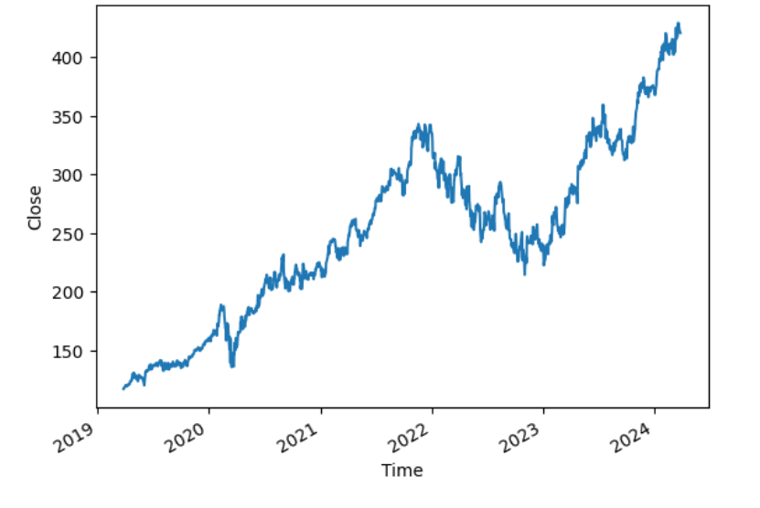
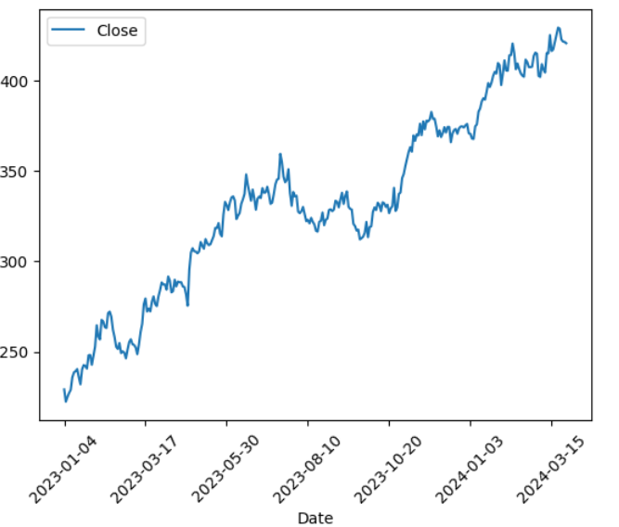
Data Exploration
Trend: Overall increasing Trend is noticed with two major declines around 2020 and 2022
Seasonality: No Seasonality/Cyclical Patterns.

Slide 5
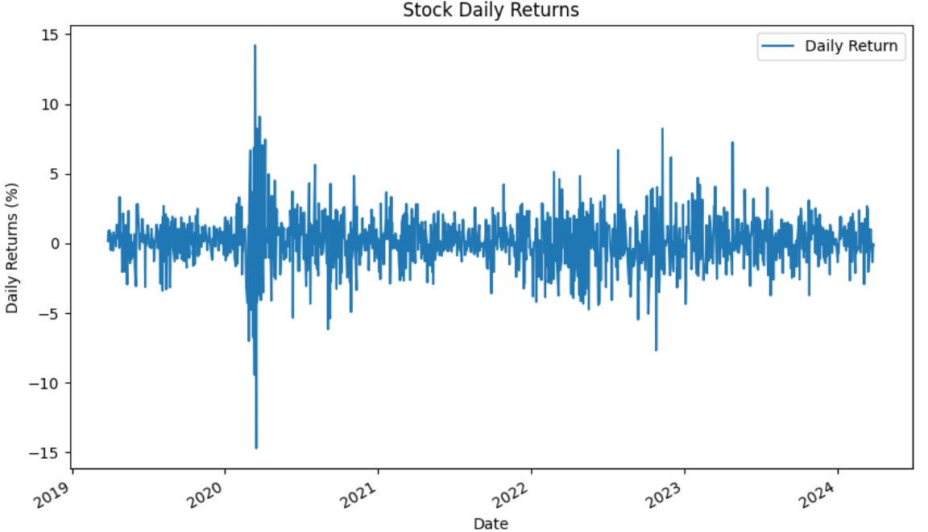
Data Exploration
What is Volatility?
Volatility is a measure of the variability or dispersion of returns, indicating the degree of fluctuation in the stock price.
Key Observations:
Too many fluctuations in the daily price
In 2020, the highest Standard Deviation was close to 15%(Peak of Covid Period).
Plot for Volatility (standard deviation of daily closing price

Slide 6
Analytical Techniques
Non-Time Series Models (with Feature Engineering):
Random Forest
Time Series Models:
Linear, Square, 3rd Power and 4th Power Trend
SARIMA
LSTM

Slide 7

Models and Interpretations Random Forest (Non Time Series)
Modelling
Results
Input Features
Open
High
Low
Volume
Lag1 (difference from the previous day’s closing price)
Target Feature
Close (closing price for the day)
Hyperparameters
n_estimators = 25
max_features = 6
Max_depth = 3
Mean Absolute Error = 9.77
Root Mean Square Error = 12.34

Slide 8
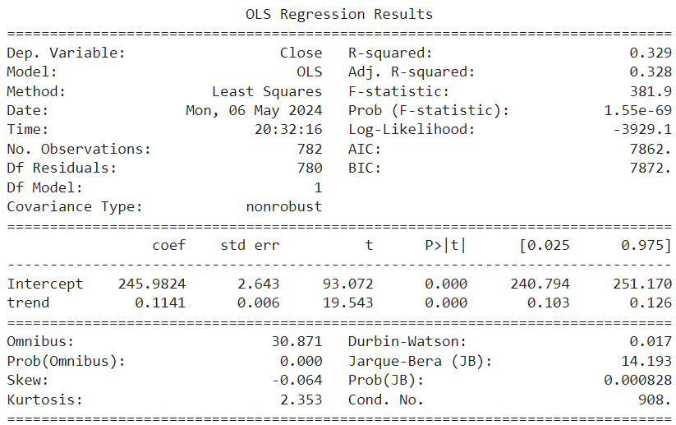
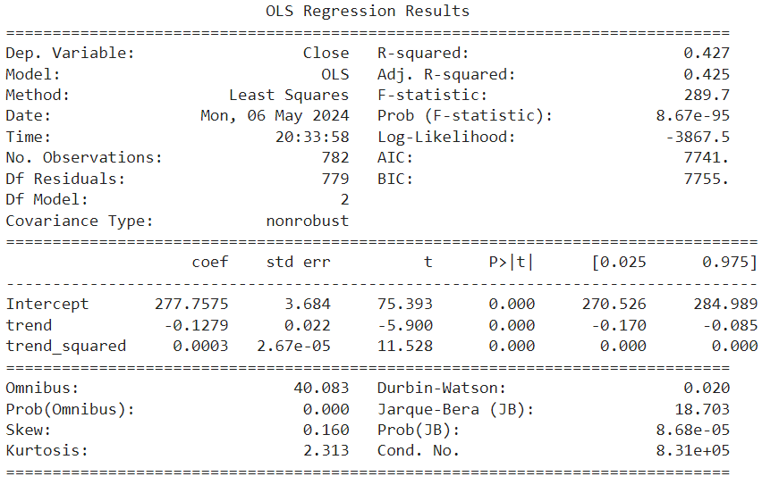
Models and Interpretations Time Series(Linear, Square, 3rd Power and 4th Power Trend)
Linear Trend Modelling
Square Trend Modeling
Regression summary:
Close ~ trend
Regression summary:
Close ~ trend + trend_squared

Slide 9
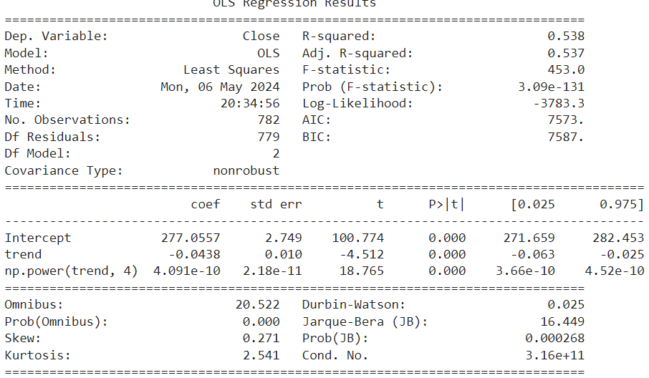
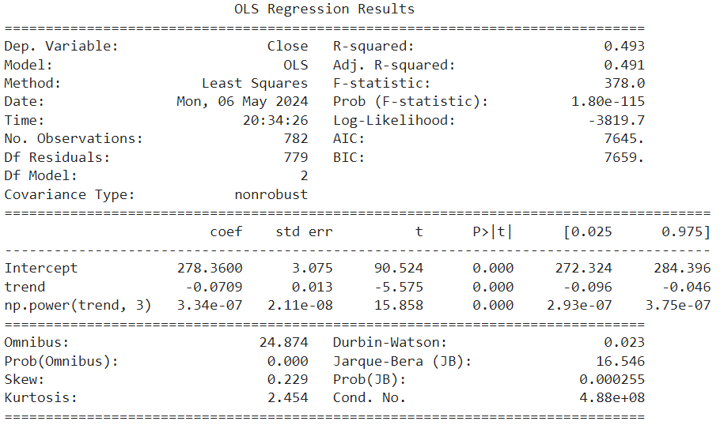
Models and Interpretations Time Series
Cubic Trend Modeling
Quartic Trend Modeling
Regression summary:
Close ~ trend + np.power(trend,3)
Regression summary:
Close ~ trend + np.power(trend,4)

Slide 10
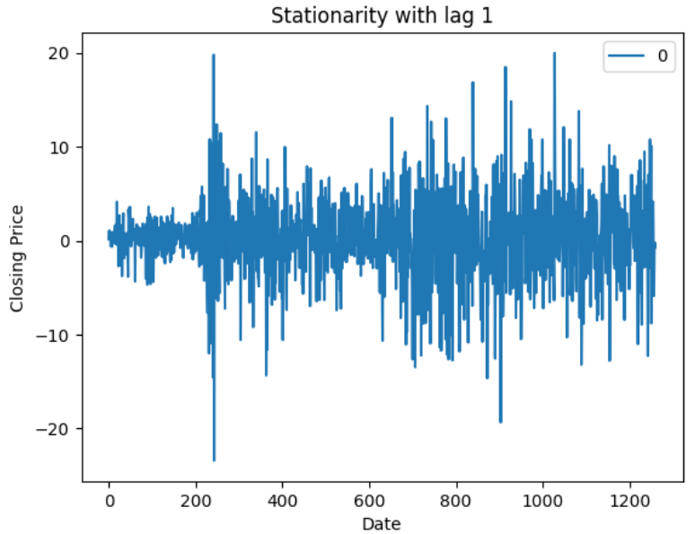
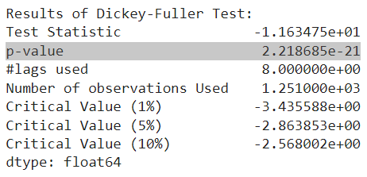
Models and Interpretations Time Series(SARIMA)
Dickey Fuller Augmentation Test
With Lag 1
Stationarity of data With Lag 1

Slide 11
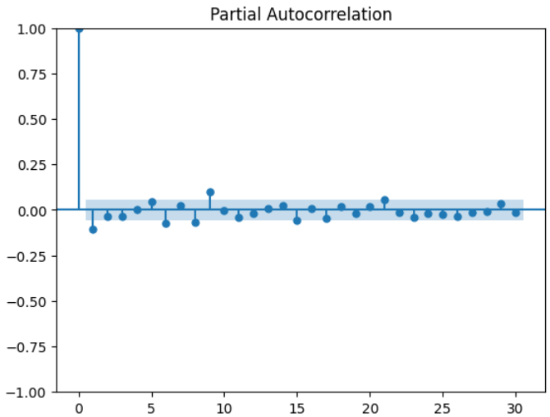
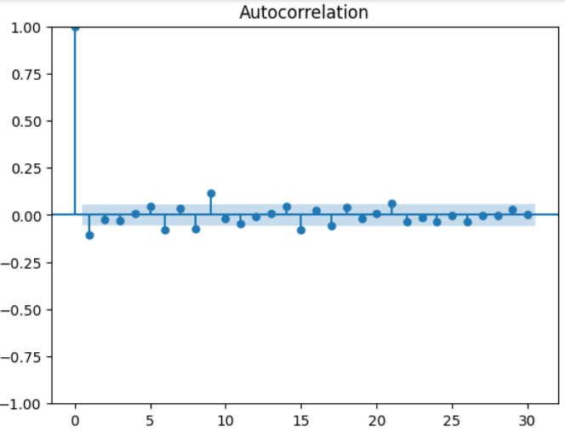
Models and Interpretations Time Series(SARIMA)
ACF and PACF plots to determine p and q values
PACF plot
ACF plot

Slide 12
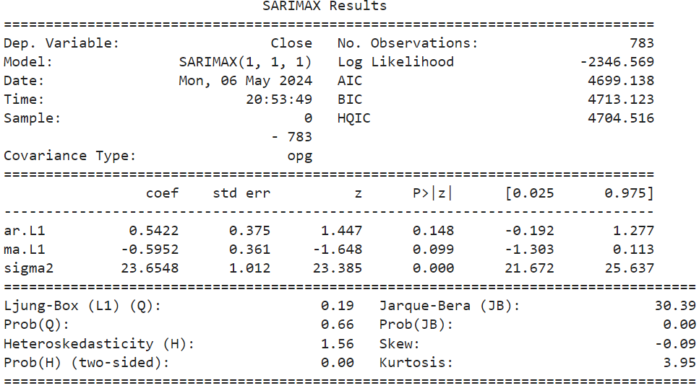
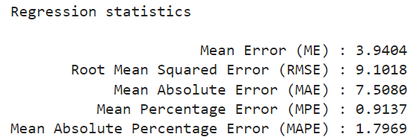
Models and Interpretations Time Series(SARIMA)
Referring to the ACF and PACF plots,
SARIMA Model Output for p=1 , q=1 , d=1, P=0, D=0, Q=0, Seasonality order =0

Slide 13
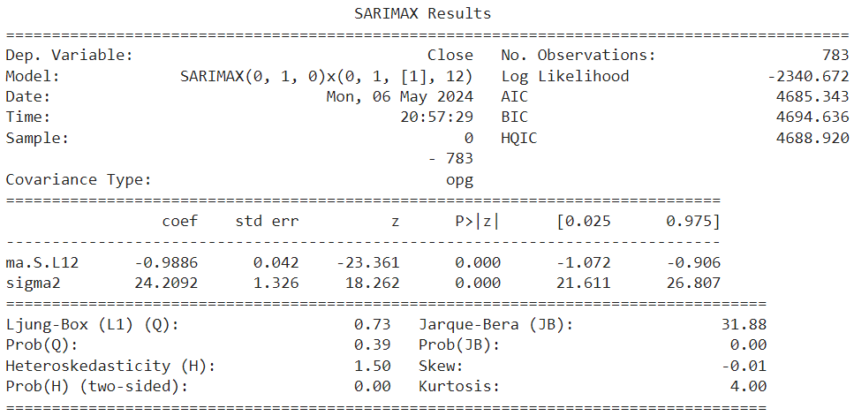
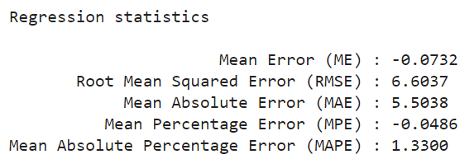
Models and Interpretations Time Series(SARIMA)
By hyperparameter tuning,
SARIMA Model Output for p=0 , q=0 , d=1, P=0, D=1, Q=1, Seasonality order =12

Slide 14

Models and Interpretations LSTM
Hyperparameters used:
Optimizer : Adam
Sequence Length: 60
Loss Function: Mean Squared Error
Epoch run : 3

Slide 15
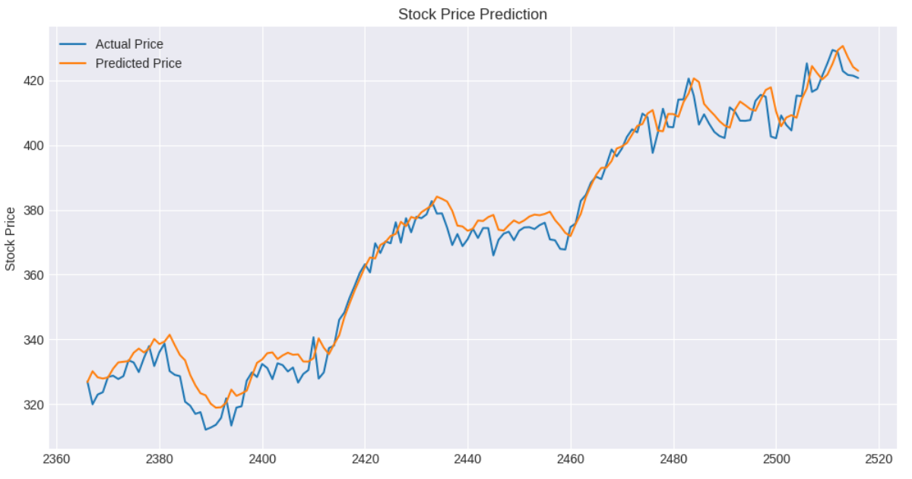
Models and Interpretations LSTM
Predicted vs Actual Price plot

Slide 16
Models Comparison
S. No. | Independent Features | Independent Features/ Parameters | MAE | RMSE
Non Time Series | Random Forest | Open, High, Low, Volume, Lag1 | 9.76 | 12.33
Time-Series | Linear Model | Trend | 76.9 | 77.5
 |  | Trend + Trend Square | 41.9 | 41.4
 |  | Trend + Trend ^ 3 | 22.4 | 21.8
 |  | Trend + Trend ^ 4 | 7.1 | 6.2
 | SARIMA | p=0, d=1, q=0 Seasonal Order = (0,1,1,12) | 6.6 | 5.5
 | LSTM |  | 4.26 | 5.33

Slide 17
Conclusion
Random Forest
Linear Model performed better with a non-linear Trend function. This supports our observation from our plot: No linear relationship seen in the trend of Stock Price.
SARIMA p and q values from the ACF and PACF charts did not yield the best performance. We got better model with hyperparameter tuning and adding seasonality.
Even if Linear Model performed well, we don’t know what kind of non-linearity will be present in the data for other Stocks.
Random Forest may be improved by adding more relevant features like Moving Averages or industry specific metric
LSTM
LSTM results show low mean square errors and predicted values following the actual values very closely.
LSTM is scalable

Slide 18
Future Steps
Random Forest:
Adding features like MAs and more Lags to see how the model performs instead of Open, High and Low values to see the performance.
Increasing the scope of Data for multiple Tickers(companies).
Modelling with Events

Slide 19
THANK YOU

